Slide 1
Mini-Project Research
Christine Gurek

Slide 2
Research Question
At what age are dancers most vulnerable to injury?
When should injury prevention education begin for dancers?

Slide 3
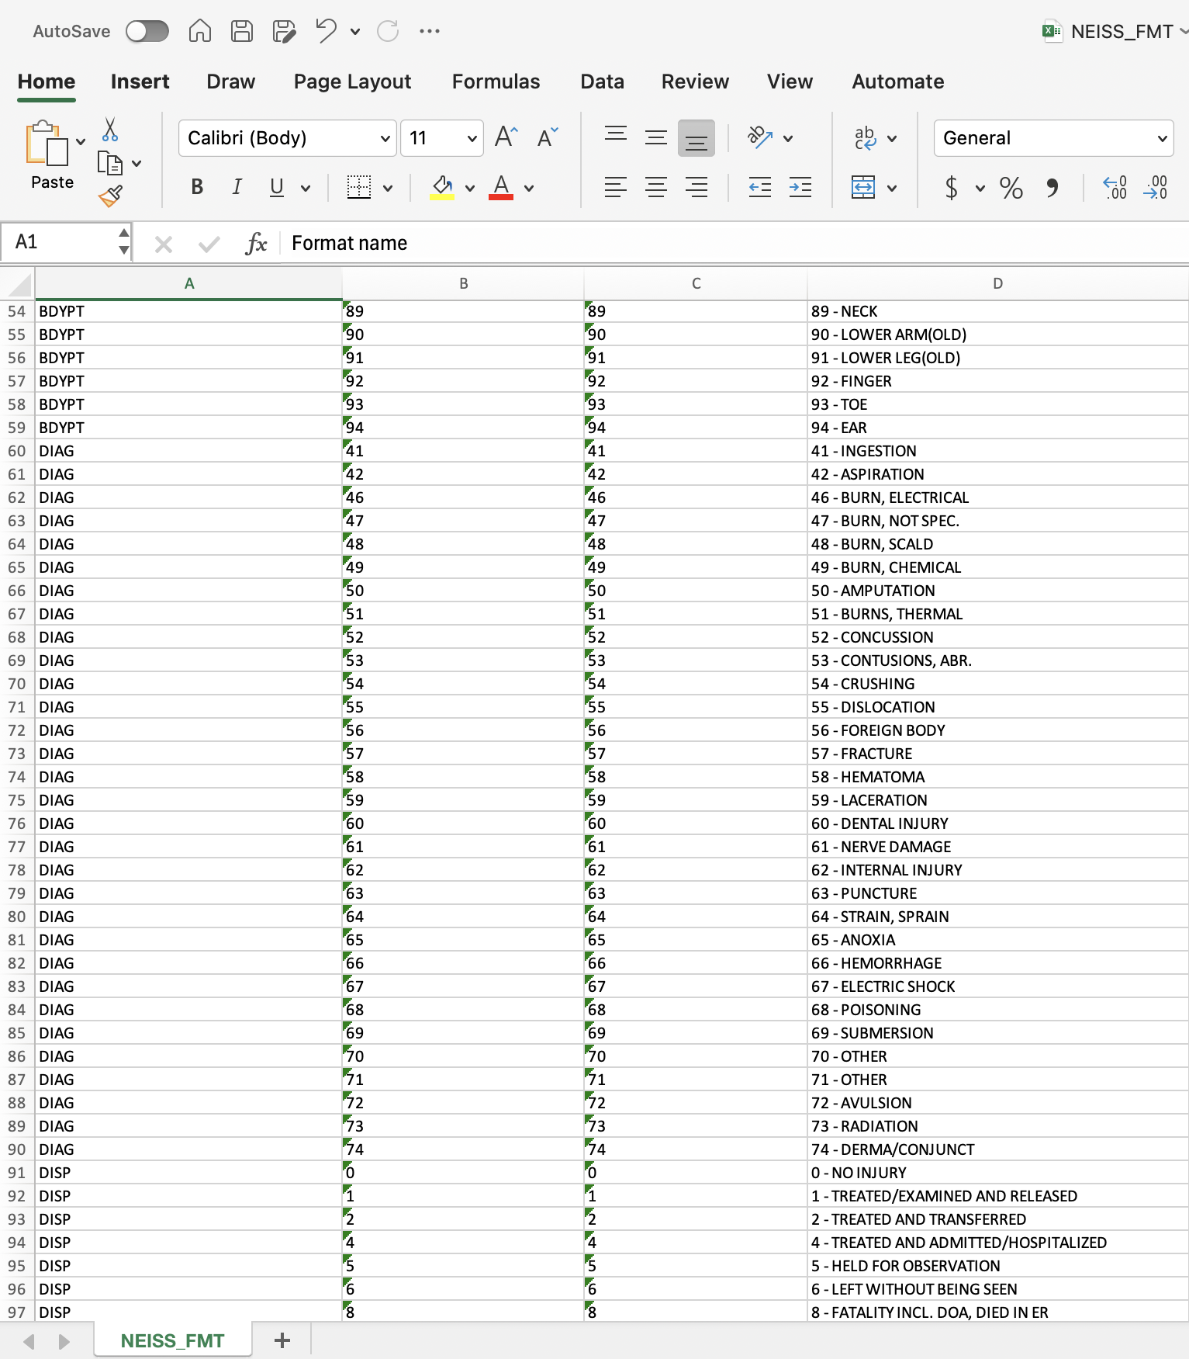
Data
NEISS Database
Submit a query for dance related injuries
Returned an excel sheet with requested data
Also returned an excel sheet that can be used as a key for the text data that was transformed into numerical data
I had 11 excel sheets; a yearly report on patients, and the key file
Notes:
National Electronic Injury Surveillance System

Slide 4
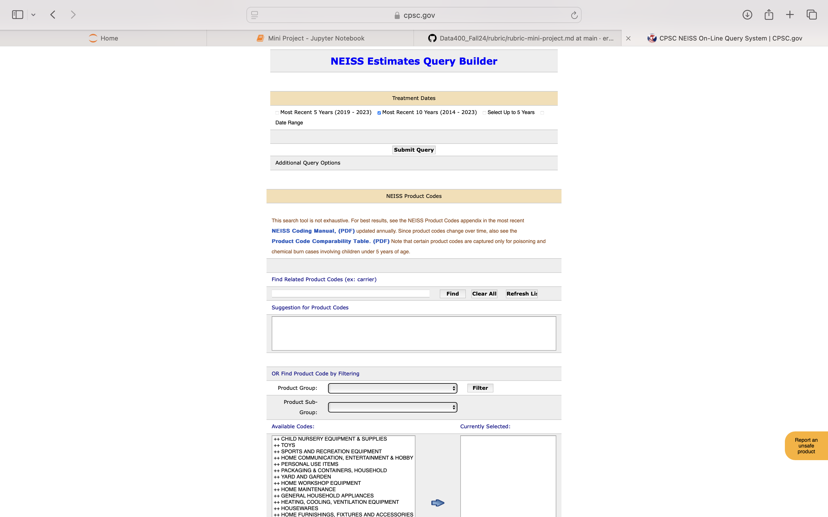
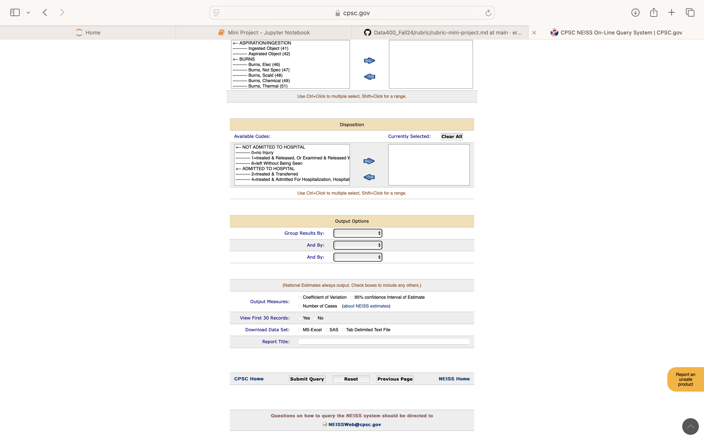
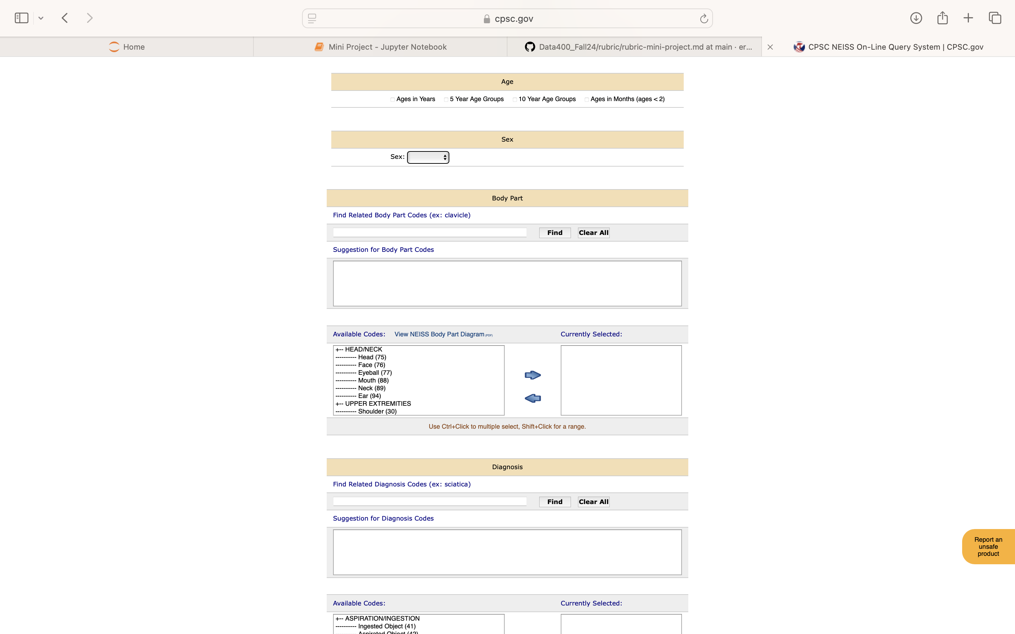
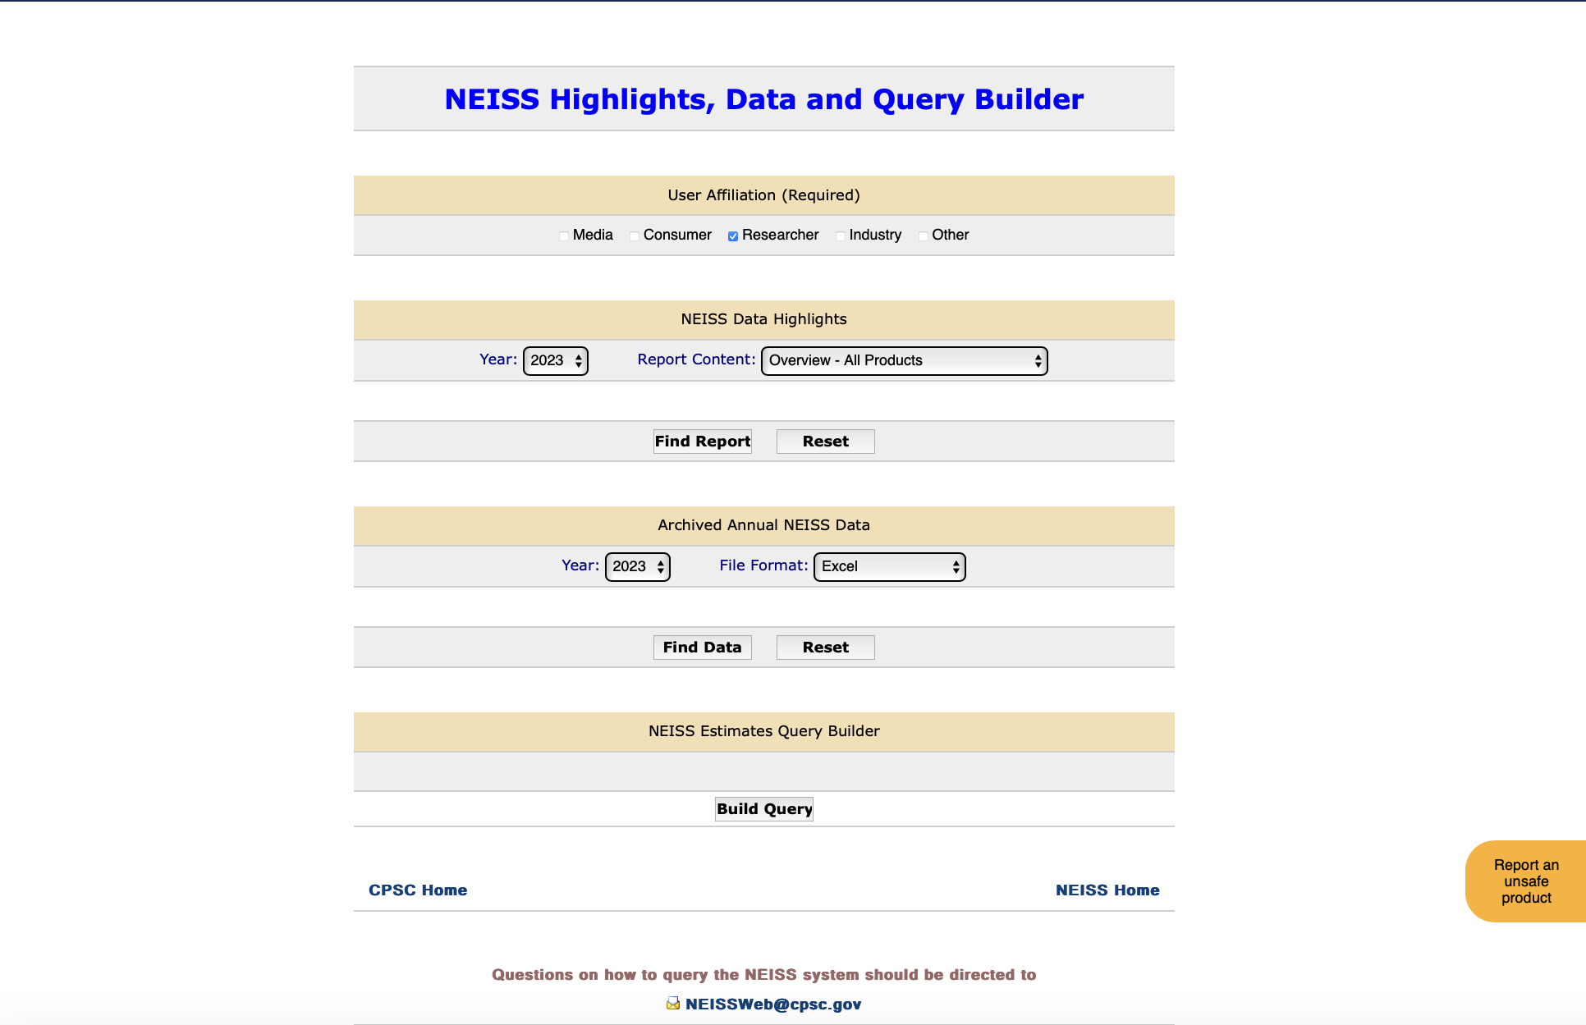
Notes:
Data Retrieval

Slide 5
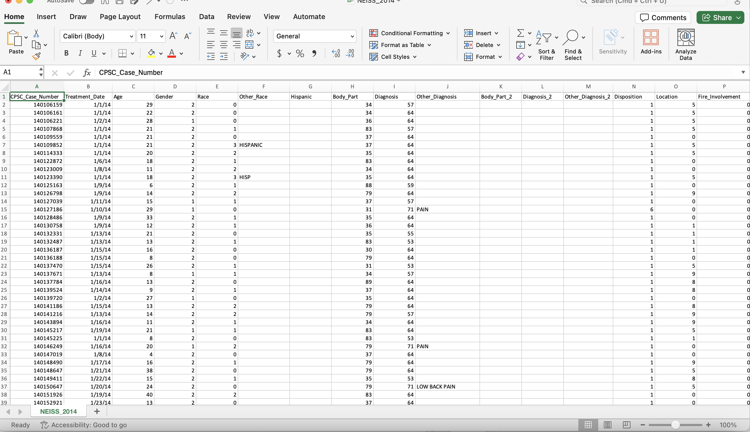
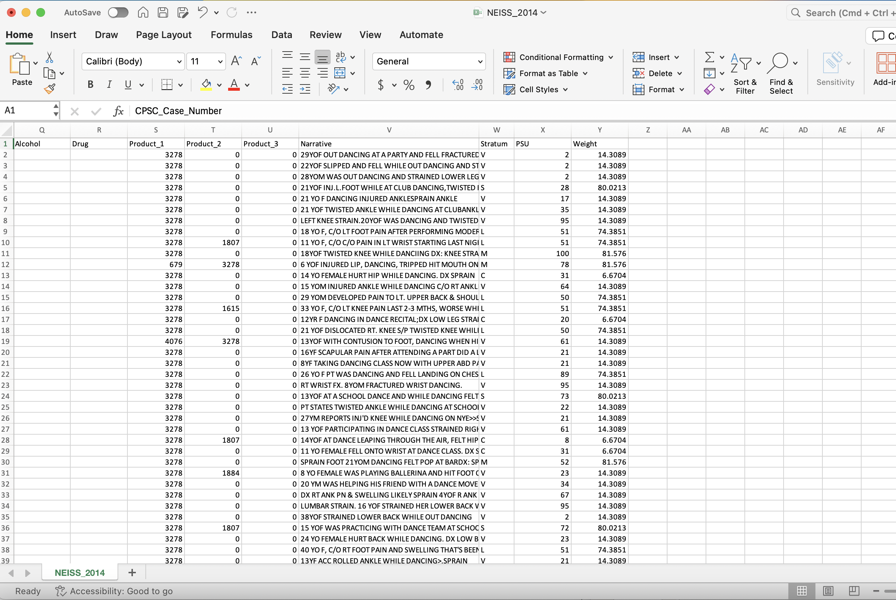
Notes:
Original Data

Slide 6
Data Cleaning Process
The first step I did was copy the data to a new excel sheet so I would still have access to an original
I removed any unnecessary columns, finished with 9 columns
I filtered the data in excel to only include cells that had the words “Dance Class” in them, so it was more likely that the patient was a long-term dancer.
I converted the excel file to a csv file
Once I imported them all into Jupyter notebook, I concatenated all of them together and was able to start my EDA.
Notes:
2. The data I received had 25 columns ranging from information about the patient, the type of injury they received, the circumstances revolving around the injury, etc. so
3. Not perfect but better than including unnecessary information that is not relevant

Slide 7
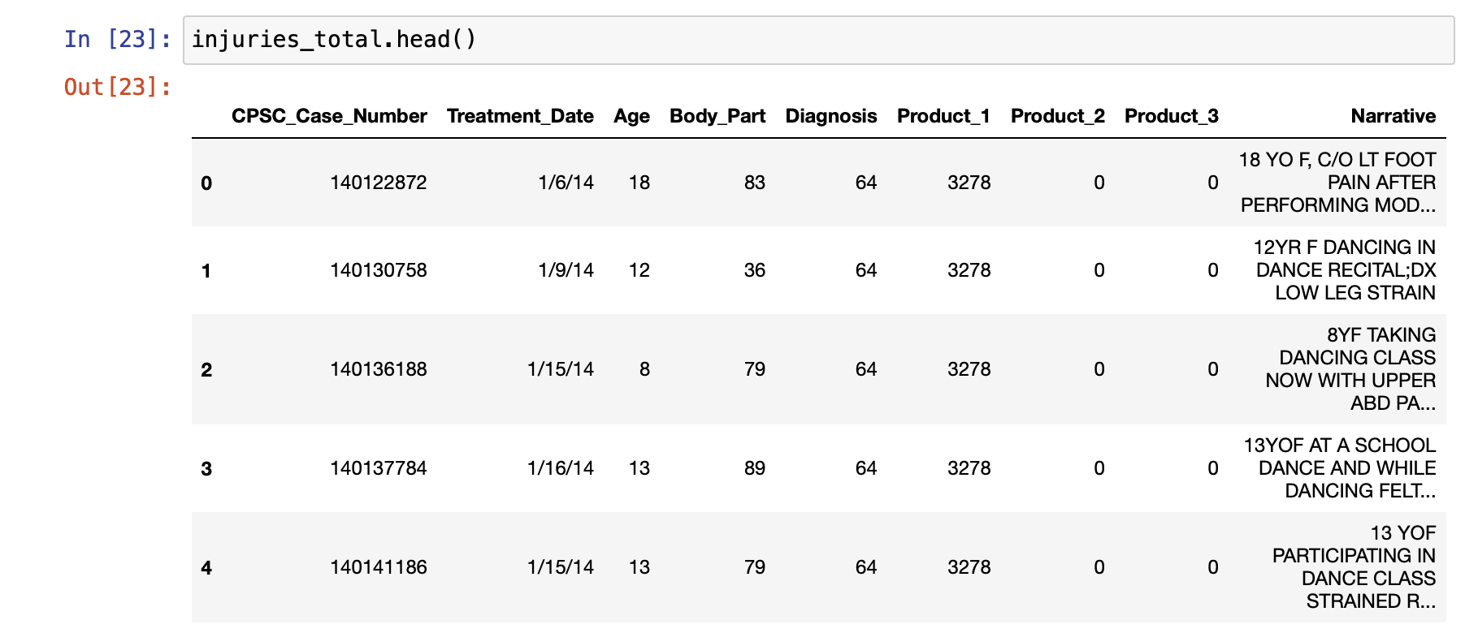
Cleaned Data
I ended with only 9 columns
CPSC_Case_Number
Treatment_Date
Age
Body Part
Diagnosis
Product_1,2,3
Narrative
There are now 4911 rows

Slide 8
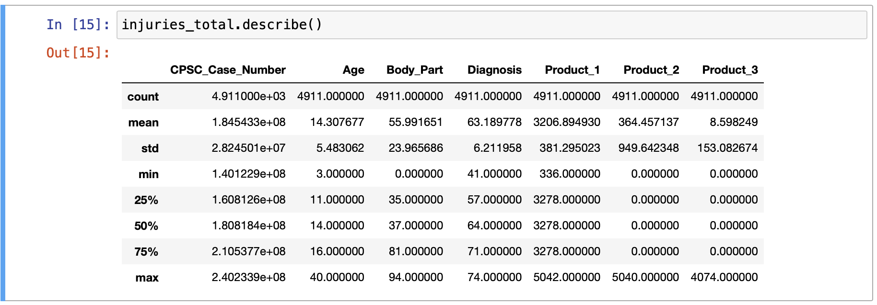
EDA
The mean age is about 14 years old, which could be helpful in answering the research question
The rest of the data represents textual data, so it is not as representative in this way
There are no missing values

Slide 9
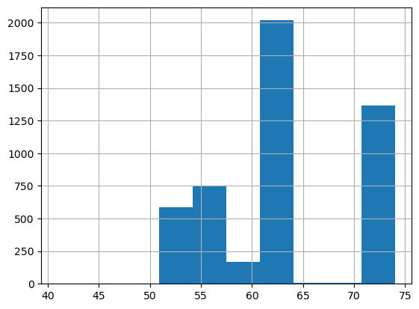
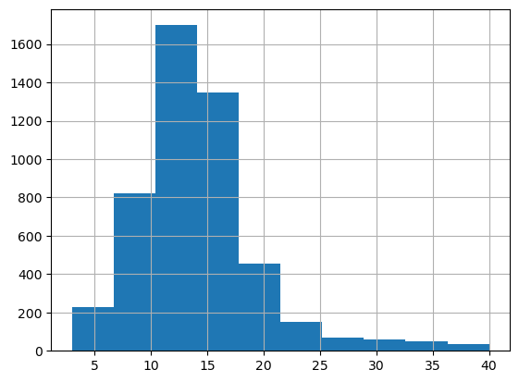
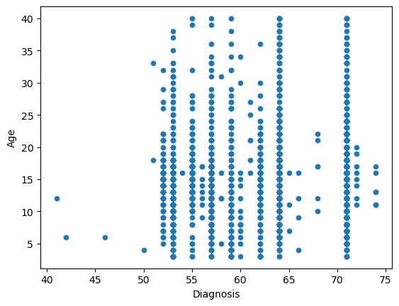
EDA
Diagnosis vs. Frequency
Age vs. Frequency
Diagnosis vs. Age
From the first histogram we can see that the most frequent diagnosis was a strain or sprain
From the second histogram we can see that the most frequent ages are between10-14 years old
There is not a clear pattern in the diagnosis vs. age graph
Notes:
Then looked at the distribution of a few columns

Slide 10
Implications for Stake-Holders
Dance Companies:
If dancers are experiencing career-ending injuries earlier on in their lives, or do not know how to properly care for their injuries, there will be less dancers able to provide long-term employment with dance companies, or the liability of their more-frequent injuries will fall on the dance company.
Dance Teams
You cannot have a successful dance team without uninjured dancers, if these injuries are more likely to happen when most dancers are on a dance team, this can impact the competitions and dance studios main source of funding.

Slide 11
Ethical Implications
Use of Medical Data
One ethical dilemma with using this data is the fact that it is medical data, although there are no identifying pieces of data, people may not like their data being put out in a public way like this.
Culture Shift
There is often a ‘dance through the pain’ culture in many studios, if there is a connection between age and injury prevention education this culture often toxic culture could be changed
Would this research be enough to get that change to happen?
Access
If a correlation was found, would all dance studios have access to this type of education?
Notes:
Knowing there is a solution but not being able to provide it could cause a lot of guilt

Slide 12
Conclusions and Considerations
Conclusion:
Through EDA it was found that the average age of the patients was 14, and the most frequent age is around 14, but generally cannot be decided as a pattern until further models and analysis are done
Considerations:
The most frequent injury was a strain or sprain, how preventable are these types of injuries?
How soon do these types of injuries add up, until they become a career ending one?
What type of injury prevention education are young dancers already receiving?

Slide 13
Questions?

